Slide 1

UNIVERSITY OF BRIDGEPORT Big data systems and analysis -CPSC-651-6T1 Faculty name: Prof. Jeongkyu lee Analysis of the occurrences of the Earthquake using hadoop
SUBMITTED BY
GROUP 7

Slide 2
Phase-1 : Selecting dataset
Natural Calamities occur without prior warning and cause a large scale loss to human life and property. This project attempts to analyze real data on last thirty days of all earthquakes occurred on earth to predict some common characteristics using Hadoop.
The Source for the dataset is taken from http://earthquake.usgs.gov/ who update their records every 5 minutes

Slide 3
Data Characteristics
time
Data Type - Long Integer
Description - Time when the event occurred. Times are reported in milliseconds since the epoch ( 1970-01-01T00:00:00.000Z), and do not include leap seconds. In certain output formats, the date is formatted for readability.
latitude –
Data Type – Decimal
Typical Values[-90.0, 90.0]
Description - Decimal degrees latitude. Negative values for southern latitudes.
longitude –
Data Type – Decimal
Typical Values - [-180.0, 180.0]
Description - Decimal degrees longitude. Negative values for western longitudes.

Slide 4
depth
Data Type – Decimal
Typical Values - [0, 1000]
Description - Depth of the event in kilometers.
mag
Data Type – Decimal
Typical Values - [-1.0, 10.0]
Description - The magnitude for the event. Learn more about magnitudes
magType
Data Type – String
Typical Values - “Md”, “Ml”, “Ms”, “Mw”, “Me”, “Mi”, “Mb”, “MLg”
Description - The method or algorithm used to calculate the preferred magnitude for the event.Learn more about magnitude types.
nst
Data Type – Integer
Description - The total number of seismic stations used to determine earthquake location.

Slide 5
gap
Data Type – Decimal
Typical Values - [0.0, 180.0]
Description - The largest azimuthal gap between azimuthally adjacent stations (in degrees). In general, the smaller this number, the more reliable is the calculated horizontal position of the earthquake.
dmin
Data Type – Decimal
Typical Values - [0.4, 7.1]
Description - Horizontal distance from the epicenter to the nearest station (in degrees). 1 degree is approximately 111.2 kilometers. In general, the smaller this number, the more reliable is the calculated depth of the earthquake.
rms
Data Type – Decimal
Typical Values - [0.13,1.39]
Description - The root-mean-square (RMS) travel time residual, in sec, using all weights. This parameter provides a measure of the fit of the observed arrival times to the predicted arrival times for this location. Smaller numbers reflect a better fit of the data. The value is dependent on the accuracy of the velocity model used to compute the earthquake location, the quality weights assigned to the arrival time data, and the procedure used to locate the earthquake.

Slide 6
net
Data Type – String
Typical Value - sak, at, ci, hv, ld, mb, nc, nm, nn, pr, pt, se, us, uu, uw
Description - The ID of a data contributor. Identifies the network considered to be the preferred source of information for this event.
id
Data Type – String
Typical Values - A (generally) two-character network identifier with a (generally) eight-character network-assigned code.
Description - A unique identifier for the event. This is the current preferred id for the event, and may change over time. See the "ids" GeoJSON format property.
updated
Data Type - Long Integer
Description - Time when the event was most recently updated. Times are reported inmilliseconds since the epoch. In certain output formats, the date is formatted for readability.
place
Data Type – String
Description - Textual description of named geographic region near to the event. This may be a city name, or a Flinn-Engdahl Region name.

Slide 7
type
Data Type – String
Typical Values - “earthquake”, “quarry”
Description - Type of seismic event.
horizontalError
Data Type – Decimal
Typical Values - [0, 100]
Description - Uncertainty of reported location of the event in kilometers.
depthError
Data Type – Decimal
Typical Values - [0, 100]
Description - Uncertainty of reported depth of the event in kilometers.
magError
Data Type – Decimal
Typical Values - [0, 100]
Description - Uncertainty of reported magnitude of the event.

Slide 8
magNst
Data Type – Integer
Description - The total number of seismic stations used to calculate the magnitude for this earthquake.
status
Data Type – String
Typical Values - “automatic”, “reviewed”, “deleted”
Description - Indicates whether the event has been reviewed by a human.
locationSource
Data Type – String
Typical Value- sak, at, ci, hv, ld, mb, nc, nm, nn, pr, pt, se, us, uu, uw
Description - The network that originally authored the reported location of this event.
magSource
Data Type – String
Typical Value - sak, at, ci, hv, ld, mb, nc, nm, nn, pr, pt, se, us, uu, uw
Description - Network that originally authored the reported magnitude for this event.

Slide 9
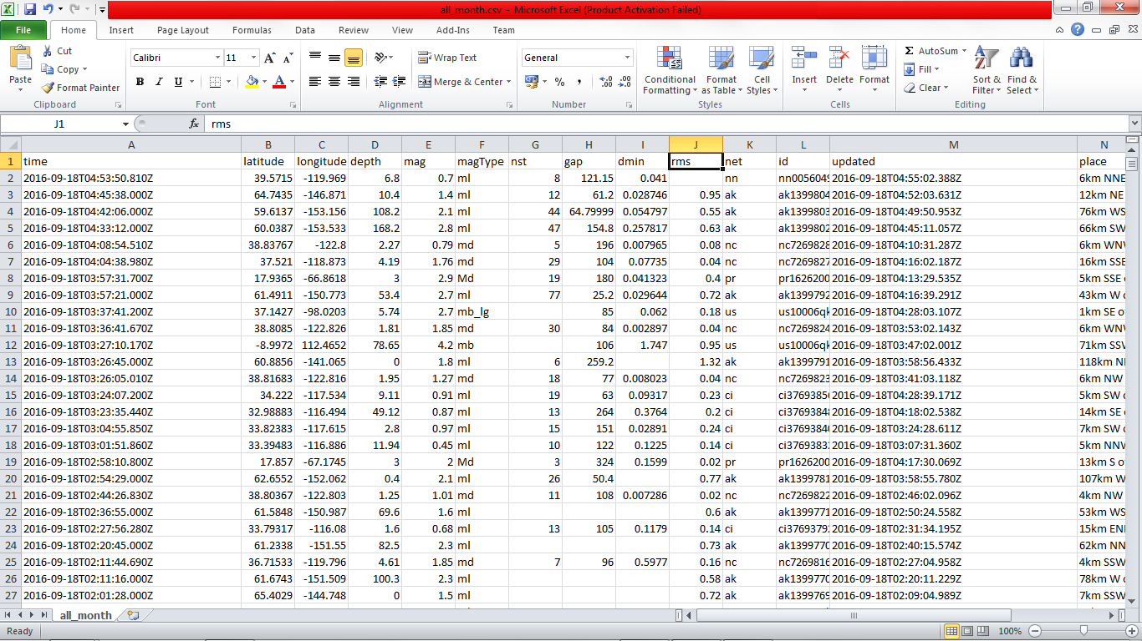
Screenshots of dataset

Slide 10
